Slide 1

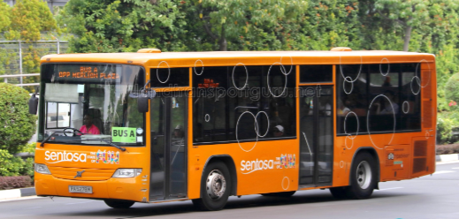

Capstone Project
Presented by: BDA09 Group05 - The Rising Seven
13 Jan 2022
Notes:
Good afternoon everyone, this is BDA09 Group 5 The Rising Seven,
we are here to present to you our solution to the challenge you are facing.

Slide 2






Introducing the team
Lee Kin Nam
Poon Wei Yuan
Koh Lay Hon (Jac)
Wesley Teo
Wong Yong Lin
Evelyn Yong
Notes:
This is our energetic project team members.

Slide 3
Executive Summary
Situation
Sentosa Development Corporation (SDC) is currently facing difficulties in meeting the demands of transporting visitors around the island during peak period when there is large number of guest waiting for buses at the bus stops.
Currently, complimentary shuttle services are operated manually through radio dispatch by service captain. It will affect the reputation of Sentosa as a tourist attraction if people leave bad reviews about slow service and long waiting time.
Solution
To better manage the surge in number of guests at bus stops, we would like to recommend a dual approach :-
Adopting a machine learning model to help SDC to preempt the hourly ridership a week ahead to allow SDC Operations team to plan its bus scheduling to cater to the guest demand; and
Adding additional features in existing Sentosa App will allow guests to view the bus arrival times so they can plan their activities accordingly without having to spend the time waiting for buses.
Impact
More dynamic scheduling ahead of demand surges instead of current fixated schedules.
Potential cost savings to remove under-utilized buses during non-peak hours.
Increase in customer satisfaction as they can better plan their time in Sentosa with knowledge of real time bus information through Sentosa App.
Notes:
We understand you are currently facing difficulties in meeting the demands of visitors during peak period who uses your complimentary shuttle services to commute around the island.
The current method of deploying additional shuttle services through manual radio dispatch during peak hours may potentially affect the reputation of Sentosa as a tourist attraction if visitors leave bad reviews about slow reactive services and long waiting time at bus stops.
To solve your problem, our team has come up with a dual approach using data and digital means by :-
1) Having a machine learning model to predict hourly ridership at bus stops to allow Operations team to plan their bus schedule a week ahead.
2) Include bus arrival time and available capacity information in existing Sentosa App to allow guests to plan their activities accordingly without having to spend the time waiting for buses.
The impact will be :-
1) With a predictive data, the Operation team able to schedule buses dynamically matching the demand instead of using a fixed time schedule of every 15 minutes;
2) And this will potentially leads to cost savings because under-utilized/empty bus deployed at non-peak hours can be removed.
3) Further, customer experience will be improved as they are able to have assess to real time bus information through the Sentosa App which allows them to better plan their time so they can spend more time at attractions and amenities and less time waiting at bus stop.
--------------------------------------------------------------------------------------------------
4) By featuring Shuttle service info via Sentosa App, this will also drive and increase chances of customer using the other features in the App (Attractions, F&B info and promotions, etc) thereby increase the revenue for SDC.

Slide 4
How might we provide better allocation of buses to bus stops to cater to ridership demand?
Notes:
How might we provide better allocation of buses to bus stops to cater to ridership demands?

Slide 5






Project Flow
Research, Analyse and Hypothesize
Data Processing
Exploratory Data Analysis
Feature Engineering
Machine Learning Modelling
1
2
3
4
5
Industry Research
Formulate the problem
Hypothesis Framing
Reading/cleaning of data
Replace/removal of null values
Merging of dataset
Understanding of data
Checking of relationship between variables
Visualising Data
Hypothesis testing
Feature selection
Create new features
Eliminate low variance features
Model Selection
Build and test model
Model prediction
Notes:
We apply a data driven approach to our solution, altogether there are 5 phases :-
Firstly, we conduct industry research, formulate the problem and frame the problems in a series of hypothesis.
We then cleansed the data obtained from both internal and external sources
Analyse and derived insights on the cleansed data
Select unique feature and creates new features for our model
Build model to train and test it to generates predictions for ridership and in turn, the bus frequency.
Next, we will share with you the results and insights of the last 3 project phases.

Slide 6
Exploratory Data Analysis

Slide 7
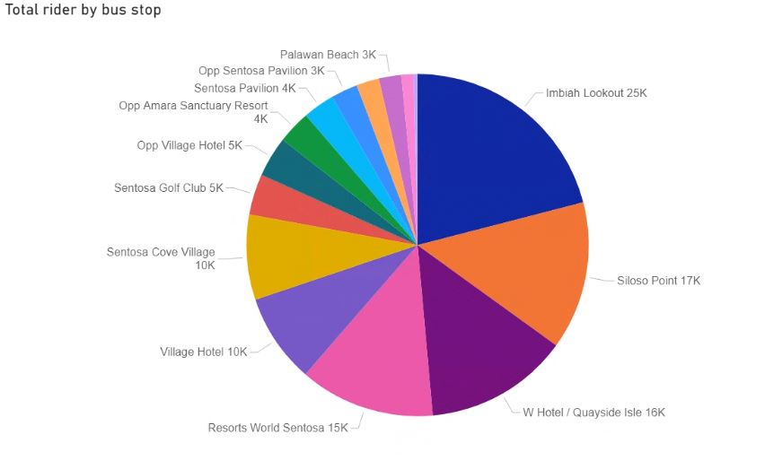
Total Ridership for Bus Stops
Exploratory Data Analysis
Imbiah lookout has the highest ridership of all bus stops.
*Beach Station is excluded in this analysis as it is a bus interchange which naturally will have high ridership.
Our focus is on the bus stops between the interchange.
Source : 3 months actual ridership data (Jan to March 2021) from SDC
Notes:
Our focus is to pre-empt the number of buses to support the peaks in ridership at the bus stops.
Therefore, we decide to look for the bus stop that has the highest ridership as the candidate to run our model prediction.
Beach station is excluded in this analysis because it is a bus interchange which naturally will have a high ridership.
Therefore, ur analysis of Jan to Mar data shows that Imbiah lookout has the highest number of riders.

Slide 8
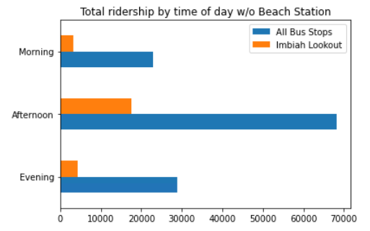
Total Ridership by time of day(All bus stops & Imbiah)
Exploratory Data Analysis
07:00 – 11:59
12:00 – 17:59
Sentosa visitors generally prefer to take the bus in the afternoon compared to other times of the day.
This suggests that most of the bus congestion happens in the afternoon.
18:00 – 23:59
Source : 3 months actual ridership data (Jan to March 2021) from SDC
Notes:
We plot a graph from Jan to March to analyse the total ridership at the time of the day.
One of our insights, we can see that overall afternoon is the peak of all the bus routes
which is the same trend at Imbiah Lookout.

Slide 9
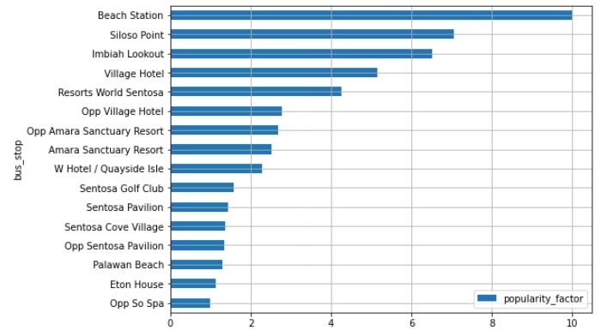
Exploratory Data Analysis
Imbiah Lookout is one of the top 3 popular bus stops
Source : 3 months actual ridership data (Jan to March 2021) from SDC
Imbiah Lookout and Siloso Point are the top bus stops with high popularity among all bus stops
The popularity factor has a correlation with the total rider. The higher the score, there will be more passengers.
Notes:
In terms of attractions, F&B, Hotels and Transport, We can see that Imbiah Lookout is one of the top 3 popular bus stops

Slide 10
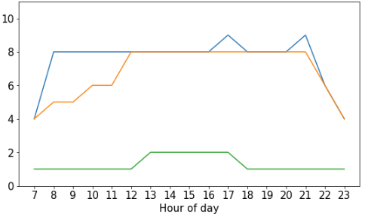
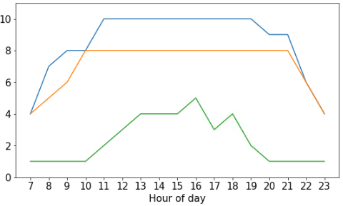
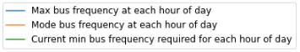
Bus Frequency of Imbiah Lookout
Exploratory Data Analysis
Weekdays
Weekends and holidays
Source : 3 months actual ridership data (Jan to March 2021) from SDC
Based on the highest ridership for every hour and taking the maximum bus capacity of 50pax, we identified that the actual bus deployment required to support the highest ridership could be more than required. There is a possibility of under-utilised buses using the current fixed bus schedule.
Notes:
11/01
We now look at the concept of bus frequency which is an important aspect to our solution. We use our ridership data and the bus capacity of 50pax per bus.
to get the number of buses that is able to pick up passengers from the bus stops.
The reason for calculating bus frequency is because we know that in 1 hour, Sentosa deploys 1 bus every 15mins.
and we wanted to find out the actual bus frequency based on the given data.
We plot the chart based on the Max, Mode, and minimum requirement of bus frequency for each time of the day
The Blue Line refers to the highest value and the Orange Line refers to the most frequent amount buses deployed at that hour.
The Green Line refers to the minimum value required to support the maximum total ridership for that hour from Jan to March
For example if we look at the weekdays chart, the minimum required bus frequency through out the day is within ONE to TWO buses instead of the current fixed bus schedule of 8 buses per hour.
As we visualize the trend of the two charts, we can see that the Green Line deployed within each hour of the day is lower than the Max and Mode of the bus frequency.
This means that the actual bus deployment required to support the maximum total ridership at Imbiah Lookout can be more than required.
Later on, we will continue to use this Green Line, our actual bus frequency, to compare with our prediction results in our Machine learning model.

Slide 11
Feature Engineering

Slide 12
Feature Selection
Feature Engineering
Features
Internal Data
(Provided by Sentosa)
External Data
Ridership Data
Holiday Flag
(Public Holidays, School Holidays)
Weather Data (weather.gov.sg)
Day of Week
Flag
Weekend
Flag
Weekday
Flag
Mid-week
Flag
Saturday
Flag
Sunday
Flag
Weekday
Holiday Flag
Weekend
Holiday Flag
Rain Flag
Average of Total Ridership
(Sum of Total In & Total Out/2)
*Predicted Variable
Dates:
1 Jan – 31 Mar 2021
Train:
1 Jan – 18 Mar 2021
Test:
19 – 31 Mar 2021
Prediction:
1 – 7 Apr 2021
Bus Frequency
(Total Ridership/50)
Bus to Amenities /
Attraction Details
Bus Routes / Bus Stops
Notes:
For the purpose of modelling we created the following features:
From the ridership data we created flags for day of the week and bus stop popularity.
Using external data, we created the rain flag and holiday flag
To measure ridership we took the sum of total passengers in and out divided by two. This was also the variable we predicted. From there, we also created a unique feature of bus frequency.

Slide 13
Machine Learning Modelling

Slide 14

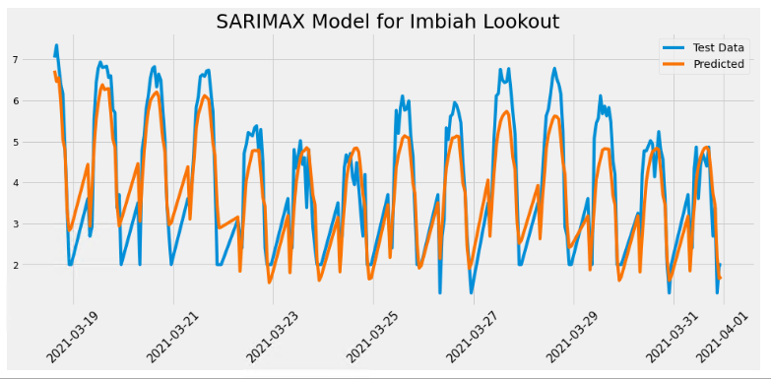
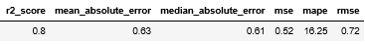
Machine Learning Modelling
Time Series Modelling (SARIMAX)
Dataset have been transformed & logged for scaling
SARIMAX Model was applied to account for seasonal trends and exogenous factors such as rain, holidays and weekends.
R2 score and Mean Average Percentage Error (MAPE) to determine accuracy of our model
Source : 3 months actual ridership data (Jan to March 2021) from SDC
Notes:
How did we come up with the model?
1. Grouped riders by the operating hours of each day across the 3 months
2. Tested for stationarity
3. Performed data transformations – Log of dataset to scale, increased all values by 2 to shift dataset by a small number and remove zeroes
4. Split data into train/test (0.85 split)
5. Exogenous dataset (Weekend Flag, Holiday Flag, Rain Flag)
6. Run auto-arima to get best order and seasonal order
7. Run SARIMAX to train model
Given the chronological nature of our dataset, we decided to go with a Time Series Model. Specifically, we used SARIMAX to account for seasonal trends and exogenous variables. To get the best accuracy, we utilized auto-arima and looping to optimize the best components. We then took the best result, which produced an R2 score of 0.8 and mean average prediction error (or MAPE) of 16.25%.
The values here are not directly indicative of ridership as they have been log transformed for scaling and will require the same transformations in reverse.

Slide 15
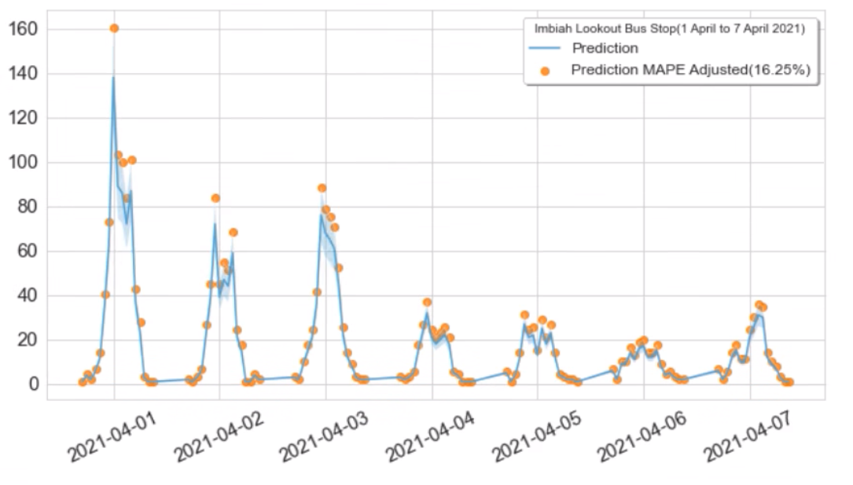
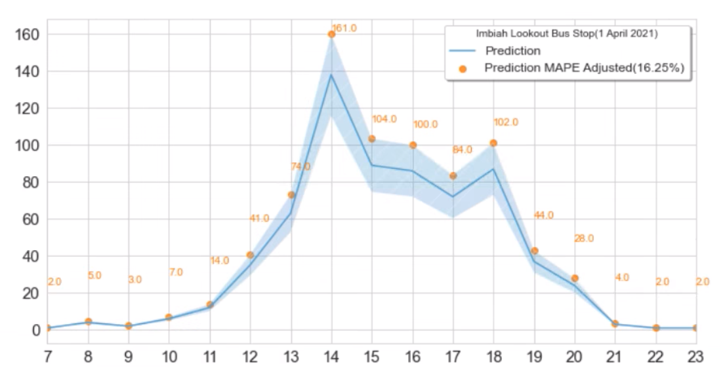
Ridership Predictions for 1st Week of April 2021
Machine Learning Modelling
Saturday (Weekend)
Good Friday (PH)
Weekly Predictions
Hourly Prediction for 1 Day
Notes:
We then set out to predict ridership for the first 7 days of April, to cover the variations across the week. To provide a buffer for error in our prediction we also provided a mape-adjusted prediction denoted by the light blue error band and orange points on the graph.
As seen in our prediction, similar trends and patterns are observed, with high ridership starting on April 1st, a Thursday. Higher than average ridership continues on Friday, a public holiday, and April 3rd which is a Saturday. This trend only begins to taper off on Sunday April 4th.
Looking at the hourly prediction by day, we see the same mid-day peaks that occur in the afternoon between the hours of two to six PM.

Slide 16
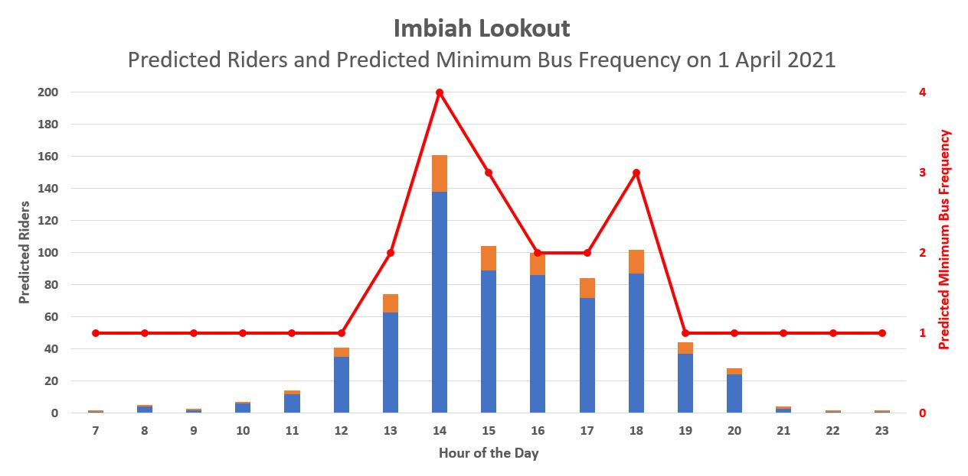
Predicted Minimum Bus Frequency Required on 1st April 2021
Difference in minimum required bus frequency due to the peaks in demand
Legend
Predicted
Ridership
Additional buffer of 16.25% according to MAPE Value in Prediction Model
Predicted Minimum Bus Frequency
Actual Weekday Minimum Bus Frequency Required (Derived from EDA)
Notes:
Building upon our ridership prediction of 1st April and using the 16.25% MAPE value as an additional buffer, we calculated the bus frequency based on the maximum bus capacity of 50pax.
We then get the minimum required bus frequency as seen in the red line in the chart. We see a surge in demand at 2pm and 6pm where approximately 4 and 3 buses would be needed that hour respectively.
Overlaying this with the actual bus frequency derived from our EDA, we see that the minimum requirement hovers around 1 to at most 2 buses.
Comparing that with our prediction, we see then that the minimum requirement differs greatly during certain hours of the day where ridership surges.
To that end, we propose that the usage of our model would allow for a better allocation of buses to meet demand in a dynamic manner as opposed to sending buses on a fixed frequency basis.

Slide 17
Other Solutions
Notes:
Apart from the prediction model, we also came with another solution.

Slide 18
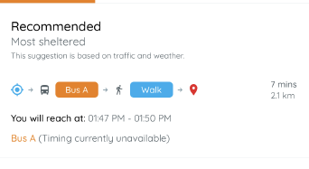
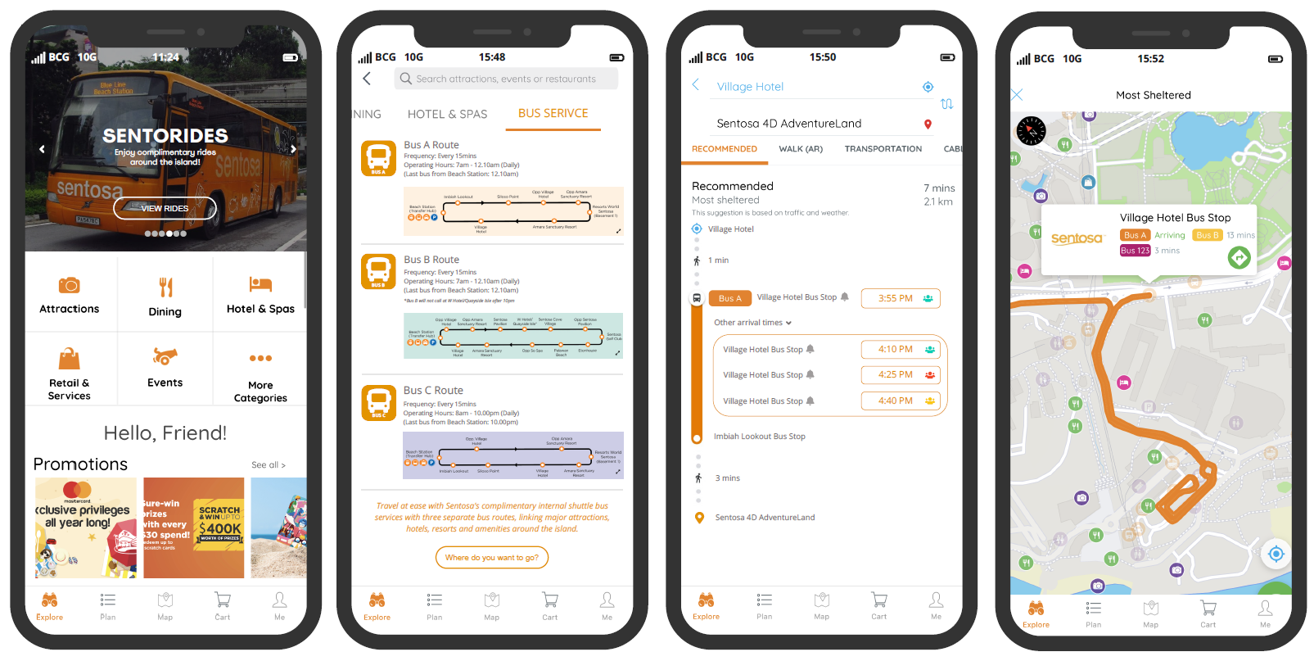

Adding features in existing Sentosa App Provide real time bus arrival and occupancy information
Addresses customer pain points in waiting for their buses.
Current Design – Missing time of arrival & available capacity
Proposed Wireframes
2
1
3
Proposed Design - Real time bus arrival & available capacity
3
1
Include Sentosa Shuttle bus Services
2
Include additional info page on the available routes
3
Provide breakdown of bus arrival time and bus capacity
Notes:
Apart from the prediction model, we also came with another solution through digital means.
We notice that the exiting Sentosa App which was free for public download has no mention of the complimentary shuttle services offered by SDC.
We have come up with a few wireframes design to include information about these free buses and their route details.
And further included real time bus arrival and available capacity information as seen in the 3rd wireframe.
These information will help visitors be aware of these services and also make informed decision in the planning of their routes without spending too long waiting for their buses. This addresses one of the major pain point from the customers point of view.
The new addition will in turn improve overall customer satisfaction which was one of Sentosa's main objectives.

Slide 19
What's Next?
Notes:
So what's next?

Slide 20







Total rider coming in and out are the same number.
No key events or promotions during the period of data provided (Jan – Mar 2021) due to COVID-19 SMM measures.
Maximum bus capacity reduced from 88 to 50 pax due to COVID-19 SMM measures.
Bus stops and bus routes cannot be removed.
Key Assumptions
Phase 1
Optimise Model
Phase 4
Phase 3
User Testing
Phase 2
Soft Launch
Build Prototype
Immediate
Acquire more data
Improve on model metrics
Consider additional features
Next steps
Time frame: 6 - 9 months
Notes:
Before we go into our next steps, here are our Key Assumptions:
1) Due to the inaccuracy of the bus detection system, we assume that the total riders coming in and out of the complete bus route are the same.
2) In view of the COVID situtaion, there are no major events or promotions during the period of data provided.
3) The maximum bus capacity is taken at 50pax due to COVID situation.
4) Given that it is not possible to remove any bus stops or routes, we decided to focus on the bus stop with the highest ridership and use it as 1st test subject to run the model.
Next, looking at a time frame of 6 to 9 months :-
As an immediate next step, we will need to acquiring longer timeframe of data, consider other bus stops, include any additional features such as information on events and programs ran during the period and look at data during non-covid period due bus capacity. This will help improve the model metrics as time series model generally requires a longer time-set of data to generate more accurate prediction.
We will then move on to phase 1 to run our predictive model and optimise it for any fine tuning.
In phase 2, we will improve the current app and model by building prototypes with the additional features.
In phase 3, we will test out our optimised prediction model with the operations team as well as the app with users for 3 months and get feedback on the app experience.
After that we will work on improving the app and the prediction model in our last phase before the soft launch of both the app and model.
Thank you for listening and we are now open to any questions.
------
In our dual approach: for the routes, we recommend to deploy the buses using our prediction model by looking at the ridership volume 1 week in advance and allocate buses based on the suggested minimum bus frequency required in a dynamic manner so as to better manage operating costs and balancing with ridership demand. As for bus stops, we recommend to share real time bus information with the visitors, such as the arrival time and available capacity in the existing Sentosa App, and/or even have digital signboards to indicate the bus information at popular bus stops.
Some of the Values and Impact we see based on our recommendations are:
1) Firstly, having a predictive approach to deploying bus instead of using the current fixed frequency helps to cut down on the manual operational work using radio dispatch of buses when there is a surge in demand.
2) Secondly, by removing under-utilised buses during non-peak hours, such as reducing the current bus frequency of 4 to at an ideal of at least 2 or having smaller capacity buses during off-peak periods due to low ridership can potentially save operational costs.
3) Thirdly, the overall customer experience will be improved as bus information are readily available so visitors can better plan their time and potentially spend more time at attractions and amenities instead of waiting at the bus stop.
4) Lastly, there will an increase the number of users using the Sentosa App, especially when it is now an all in 1 app. Users need not open multiple apps just to check the bus routes such as google map, which may not be as accurate as the data is not directly provided by Sentosa. Besides the routes, there will also be an increase in visibility for other features in the app, such as the events, promotions and other attractions.
-------------
Time series model requires a longer time data (at least 1 year) in order to give more accurate predictions (current data is only 3 months).
Bus detection system unable to accurately detect actual count (Total In & Total Out does not match).
Bus stops and bus routes cannot be removed.
Baseline on customer satisfaction rating is unknown.
Finally, in the process of coming up with this model, some of the limitations were taken into consideration:
1) Firstly, a time series model generally requires a longer set of data in order to give a more accurate prediction, however we have only 3 months data, hence with more, we are able to come up with better prediction in our immediate next steps.
2) Secondly, we notice that the total in and total out does not match due to the inaccuracy of the bus detection system, hence assuming that total in and out are the same, we took an average number of total in and total out for our analysis.
3) Thirdly, given that it is not possible to remove any bus stops or routes, we decided to focus on the bus stop with the highest ridership, addressing the major pain points in reducing the surge in demand at the bus stop and allow visitors to travel to their destination without waiting too long for their buses.
4) Lastly, the baseline on customer satisfaction rating is unknown, hence, we suggest either having feedback or surveys in the app or onsite for further analysis and future improvements.
Thank you for listening. We are now open to any questions.
---------------------------------
Limitations:
- 3 month data - the time series model requires a longer time data (preferably a year) in order to give more accurate predictions.
- Bus detection system – lack of accurate person to person scanning, don’t know actual in and out form scanner. No ticket issued.
- Bus stops and bus routes cannot be removed.
- No baseline on customer satisfaction rating
- Limited dataset due to COVID-19 situation, number of tourist dropped
- Not possible to measure customer satisfaction when there is no measurement involved.
(Provided by SDC: Our guest satisfaction is based on the overall experience on the island. Transportation/ accessibility may somewhat influenced the overall experience. These may include the wait time for the buses, whether pax are able to board the bus, and the convenience of getting around the island.)
Because of Covid-19 SMM measures there are no key events in Sentosa from Jan'21 to Mar'21. But typically, there will be promotion/ deals during the festive period and Mar School holidays.
Maximum capacity is 88 pax. But post CB period, we have capped it at 50 pax due to Safe Measurement Measures (SMM)
Suggestion for Q&A:
Improve on the passenger detection and counting system for better accuracy and reliability
- Compare analytics based on new predicted bus frequency vs
What other analytics we could do with more data:
List down additional analytics that could be done if more data were available. A good starting point could be by revisiting your assumptions or inferences made in situations where you did not have the exact data you needed
How we could operationalize:
Think about tangible next steps to execute the use-case
For example,
Validate assumptions
Map out limitations of data. Identify solutions to solve the limitations
Identify risks
Gauge impact on results/sensitivity analysis
Engage key stakeholders
Create detailed business plan
Submit proposal for approval
Etc.

Slide 21
Q & A

Slide 22
Appendix

Slide 23
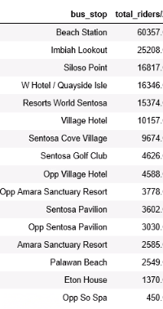
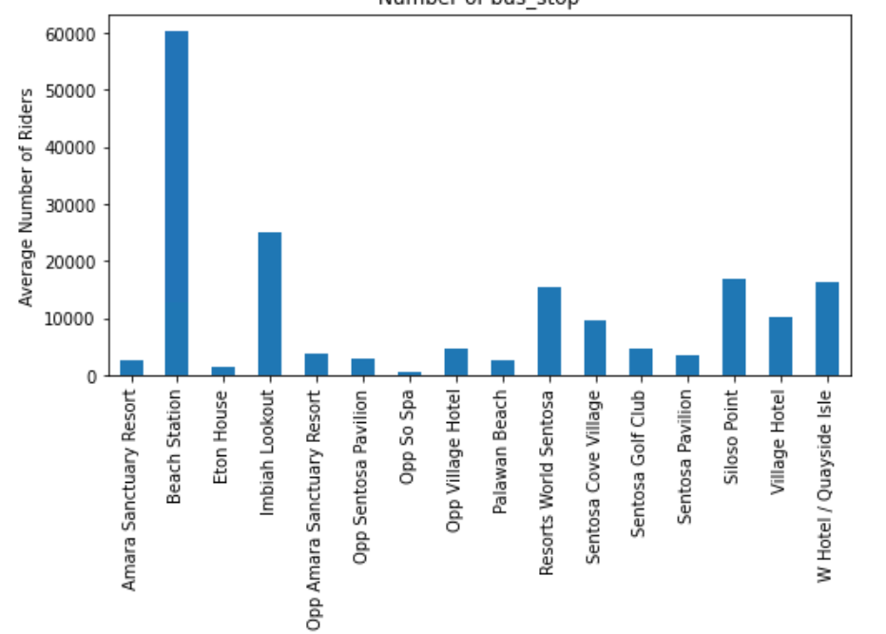
Total ridership for bus stops (including Beach station)
Exploratory Data Analysis
Analysing average number of riders against bus stops
60,357
25,208
16,817

Slide 24
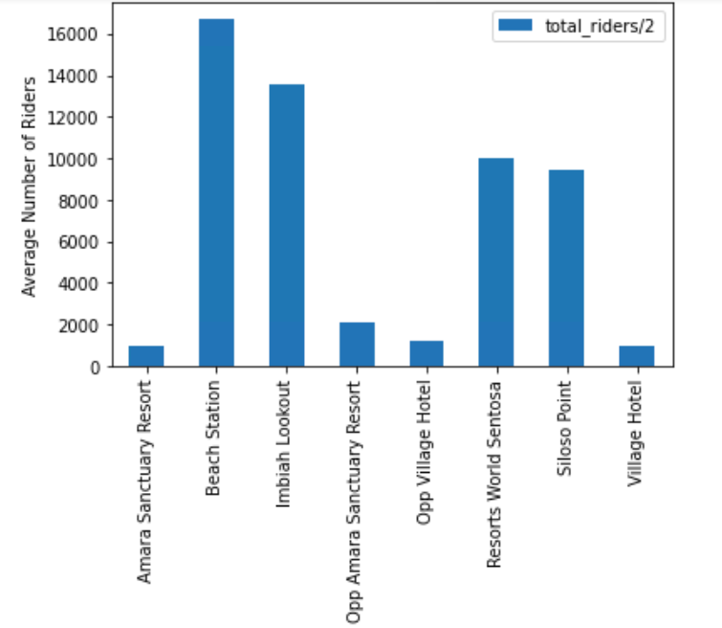
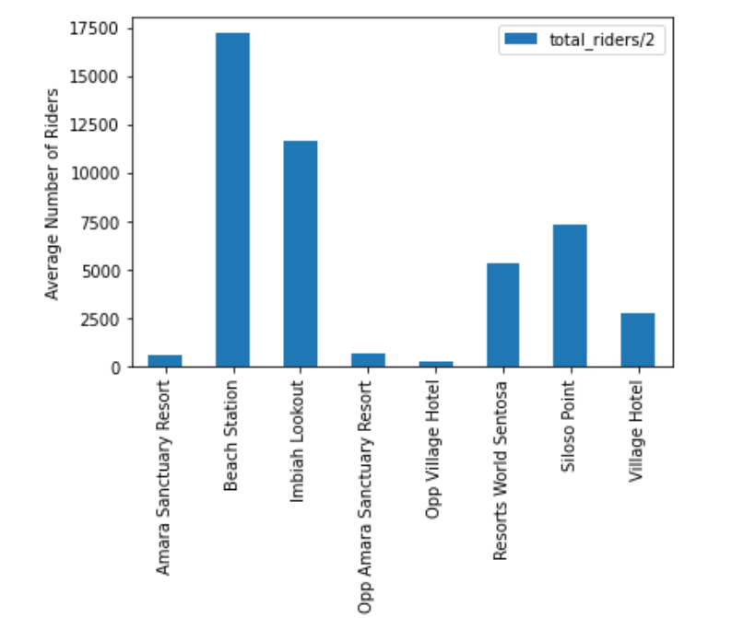
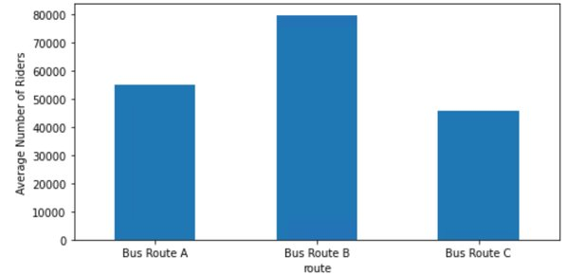
Exploratory Data Analysis
Imbiah Lookout and Siloso point are the top 2 most popular bus stops (ridership)
Bus Route A
Bus Route C
All 3 Routes

Slide 25
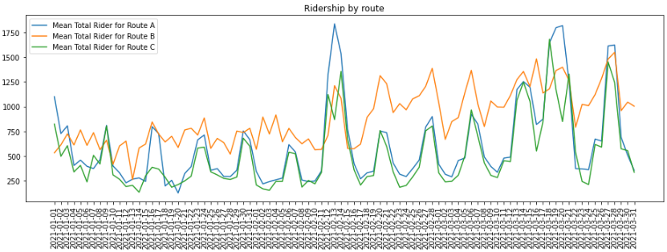
Total ridership by route
Exploratory Data Analysis

Slide 26
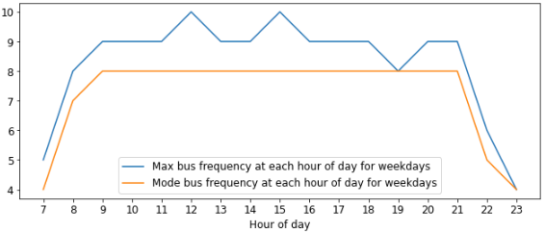
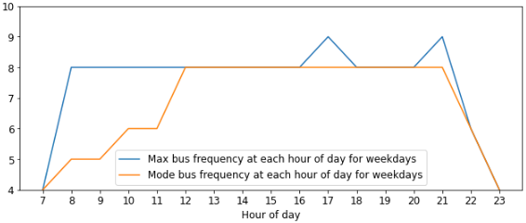
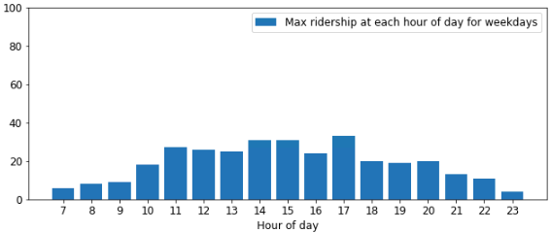
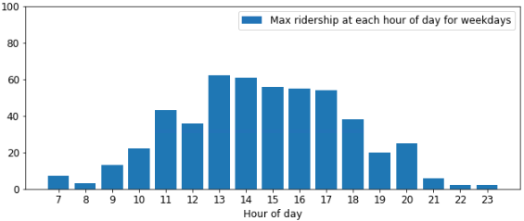
Bus Frequency of top bus stops Siloso Point and Imbiah Lookout (Weekday)
Exploratory Data Analysis
Siloso Point
Imbiah Lookout
Based on maximum bus ridership within each hour and bus capacity of 50, actual frequency of buses deployed within each hour on weekdays is higher than required.

Slide 27
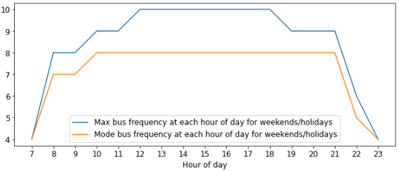
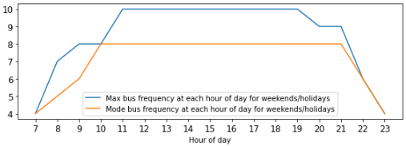
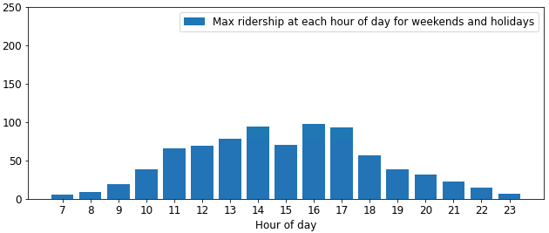
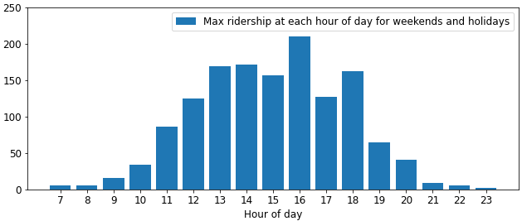
Bus Frequency of top bus stops Siloso Point and Imbiah Lookout (Weekend/holidays)
Exploratory Data Analysis
Siloso Point
Imbiah Lookout
Based on maximum bus ridership within each hour and bus capacity of 50, actual frequency of buses deployed within each hour on weekends is higher than required.

Slide 28
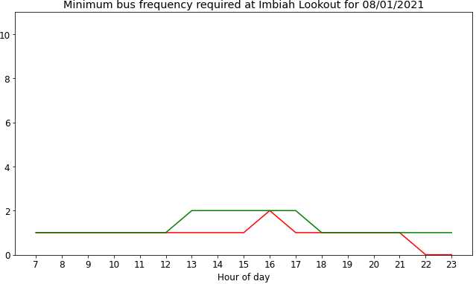
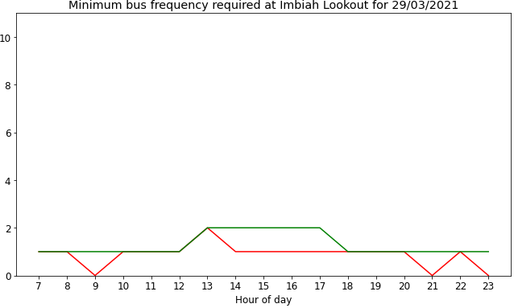
Comparing Minimum Bus Frequency Required: Selected Weekday vs 3 Months of Weekdays Data
Exploratory Data Analysis
Notes:
SANITY CHECK – by selected 2 sample days

Slide 29
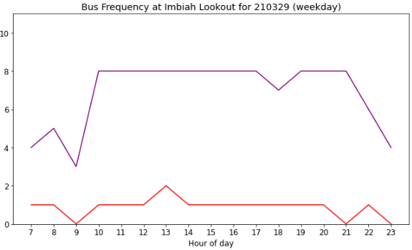
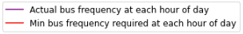
Select Weekday Bus Frequency Comparison: Actual Bus Deployed vs Minimum Bus Frequency Required
Exploratory Data Analysis

Slide 30
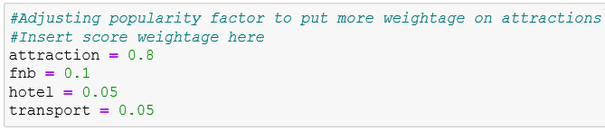
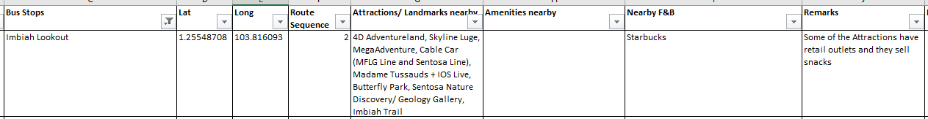
Calculation for Popularity Factor
Exploratory Data Analysis
The score for Popularity Factor is calculated with the following weightage.
We put Attraction as the highest percentage as we want to focus on guests more interested in Attractions compared to F&B and Hotels.

Slide 31
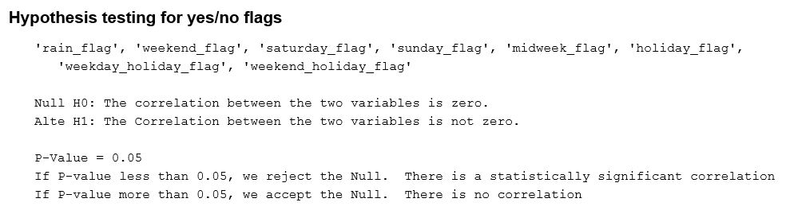
Hypothesis Testing for Correlation between Variables
Exploratory Data Analysis
Mannuwhitneyu test | Rain flag | Weekend flag | Saturday flag | Sunday flag | Midweek flag | Holiday flag | Weekday Holiday flag | Weekend Holiday flag
P-Value | 0.00 | 0.00 | 0.00 | 0.00 | 0.99 | 0.00 | 0.00 | 0.00
Null H0 | Reject | Reject | Reject | Reject | Accept | Reject | Reject | Reject
Variable flag and Total Riders are correlated if P-Value is less than 0.05
The variable flag will affect the total ridership if they are correlated.

Slide 32
Appendix:
Modelling Test For Daily Prediction

Slide 33
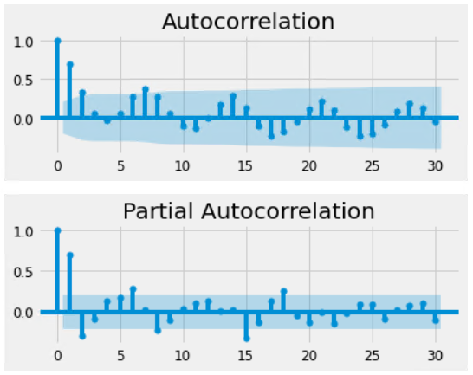
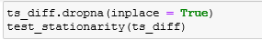
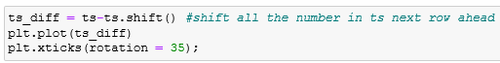
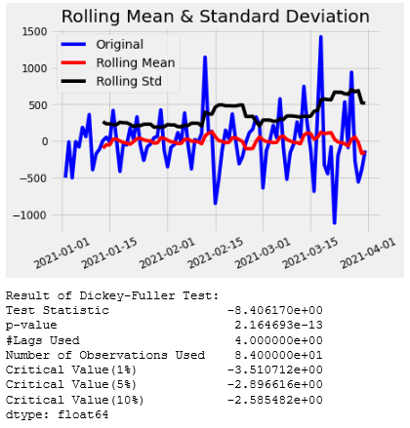
Preprocessing for Modelling Test for Daily Prediction
Machine Learning Modelling
TS with Difference Technique & Stationarity Test
TS's ACF & PACF

Slide 34
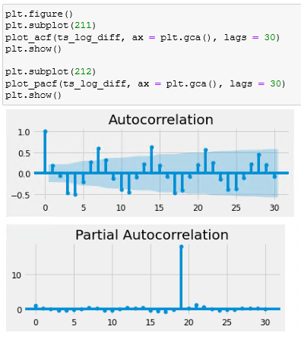
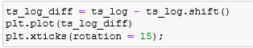
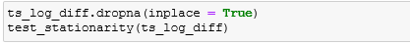
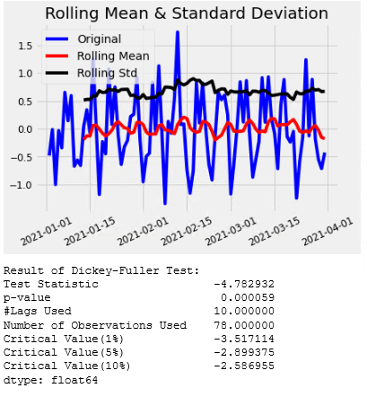
Machine Learning Modelling
Preprocessing for Modelling Test for Daily Prediction
TS Log Transformed with Difference Technique & Stationarity Test
TS Log Diff's ACF & PACF

Slide 35
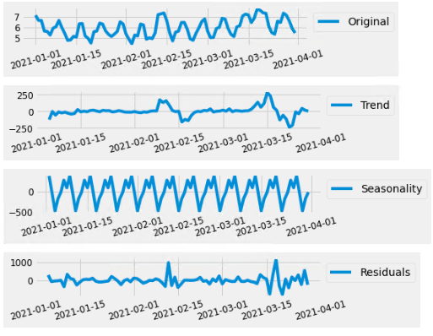
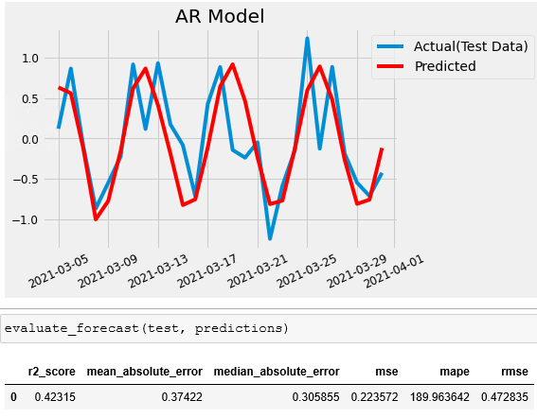
Modelling Test for Daily Prediction
Machine Learning Modelling
TS Diff's ACF & PACF
AR Model with TS Diff (No Exog Parameters)

Slide 36
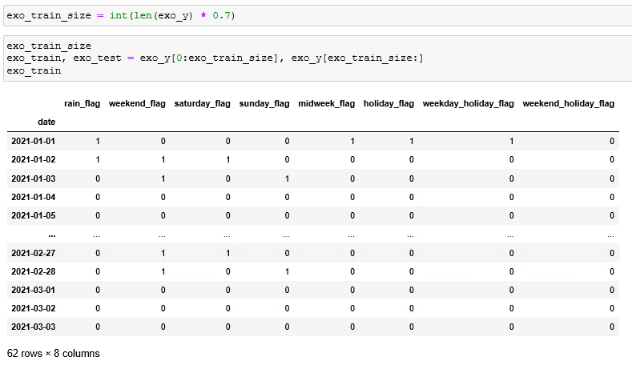
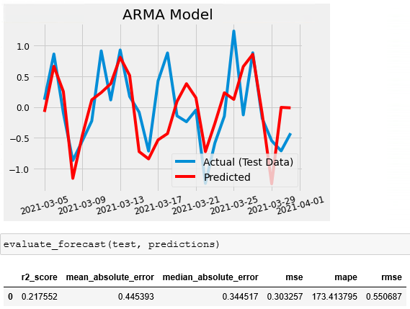
Machine Learning Modelling
Modelling Test for Daily Prediction
ARMA Model with TS Diff(With Exog Parameters)
Exog Variables Tabular Format

Slide 37
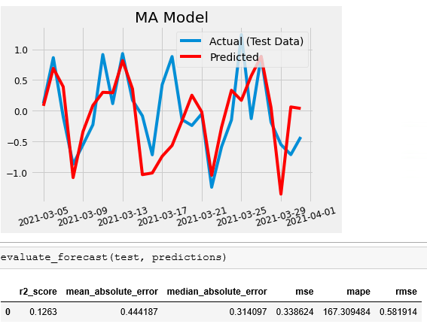
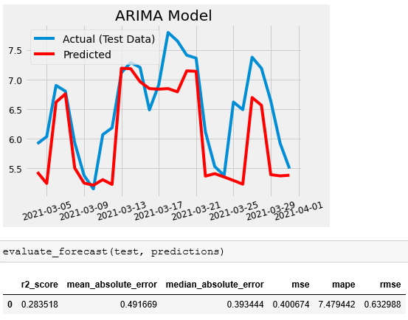
Machine Learning Modelling
Modelling Test for Daily Prediction
(Moving Average & Arima)
MA Model With TS Diff (With Exog Parameters)
ARIMA Model with TS Log (With Exog Parameters)

Slide 38
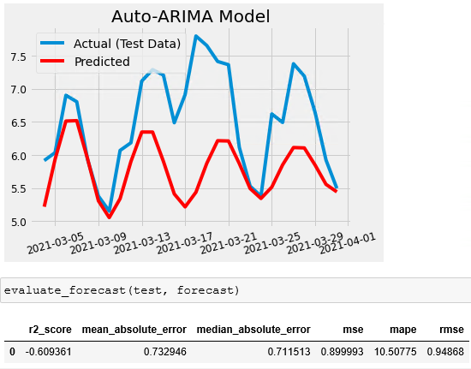

Machine Learning Modelling
Modelling Test for Daily Prediction
(Auto Arima & Auto Sarima)
Auto Arima Model With TS Diff (With Exog Parameters)
Auto Sarima Model with TS Log (With Exog Parameters)

Slide 39



Modelling Test for Daily Prediction
(Tune Sarimax & Tune Sarima)
Machine Learning Modelling
Example of Tune SARIMAX Model With Ts Log, Different Combination of PDQ, Seasonal PDQ (With Exog Parameters)
Tune Sarima Model with TS Log
(With Exog Parameters)

Slide 40

Modelling Test for Daily Prediction
(Sarimax)
Machine Learning Modelling
Sarimax Model with TS Log(With Exog Parameters)

Slide 41
Appendix:
Modelling Test For Hourly Prediction

Slide 42


Preprocessing for Modelling Test for Hourly Prediction
Machine Learning Modelling

Slide 43


Machine Learning Modelling
Preprocessing for Modelling Test for Hourly Prediction

Slide 44

Machine Learning Modelling
Modelling Test for Hourly Prediction – Imbiah Lookout
(Sarimax - Train)

Slide 45
Machine Learning Modelling
Modelling Test for Hourly Prediction – Imbiah Lookout (Sarimax - Test)

Slide 46

Machine Learning Modelling
Modelling Test for Hourly Prediction – Siloso Point
(Sarimax - Train)

Slide 47


Machine Learning Modelling
Modelling Test for Hourly Prediction – Siloso Point
(Sarimax - Test)

